Slide 1
Otto Group Product Classification
Machine Learning M2 AIC
Members:
VU Trong Bach
NGO HO Anh Khoa
Divya GROVER
Mahmut CAVDAR

Slide 2
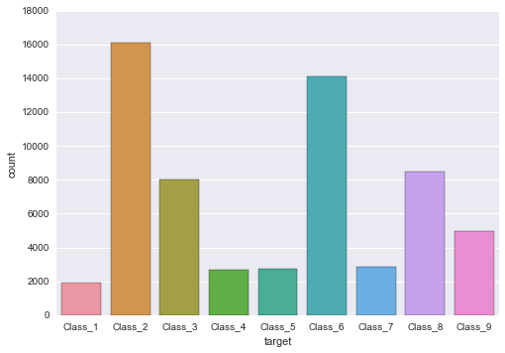
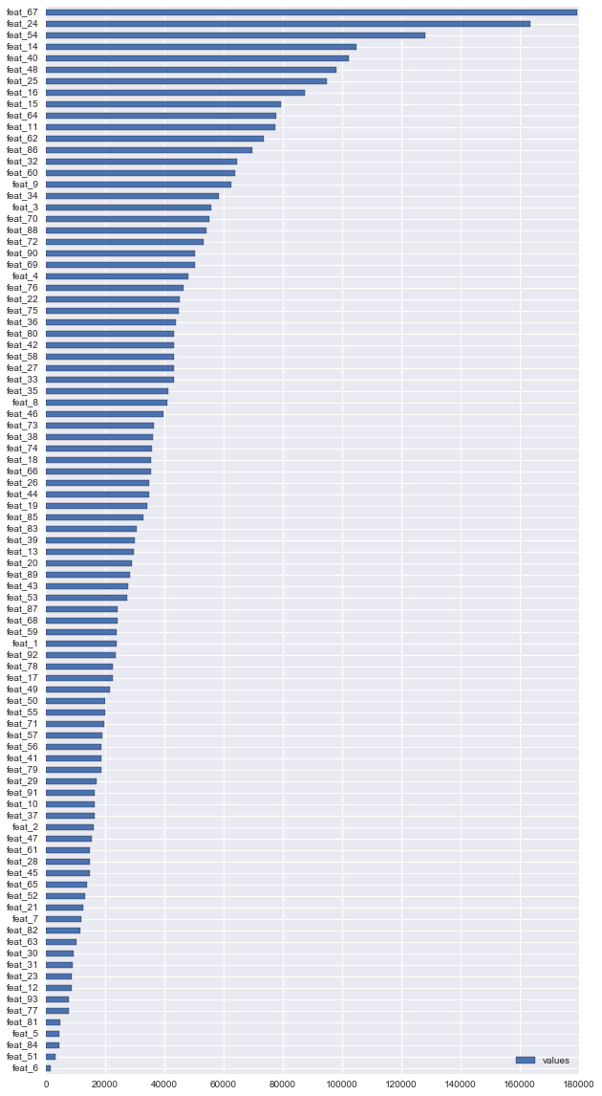
Introduction
Label: Class_1, Class_2, ..., Class_9
Features: 93 numerical features [0, 352]
Training: 61.878 samples
Testing: 144.368 samples
Four different approaches:
Naive Bayes
Decision Tree - Extra Tree
LinearSVC
XBoost

Slide 3
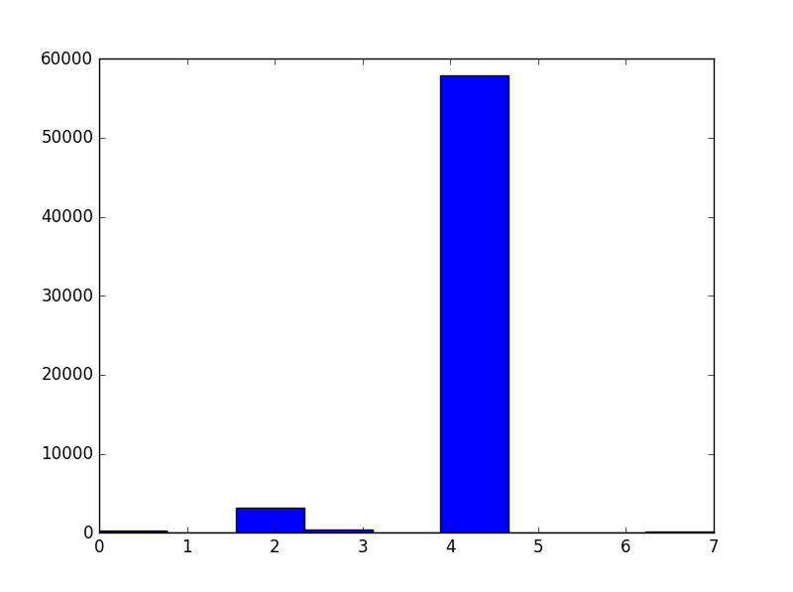
Naive Bayes
Treated as Baseline algorithm
Crude Naive Bayes gives score of 11.0 on private leaderboard
Naive Bayes with probability calibration and cross-validation improves the score to 1.01, compared to the best score of 0.382
A look(Fig below) into the spectral clusters for the training data suggests:
The fact that almost all samples cluster into one group suggests that the features are implicitly not very discriminative
The data is not very geometrically separable, hence boosting algorithms might perform better than any other decision-surface methods

Slide 4
LinearSVC
Parameters:
one-vs-the-rest, class_weight = balanced
GridSearchCV
10-Fold
penalty, loss, C, tol, max-inter
CalibratedClassifierCV
isotonic
Testing set logloss
0.66940
LinearSVC(penalty='l2', loss=squared_hinge, tol=0.0001, C=1.0, max_iter=1000)
CalibratedClassifierCV(method='isotonic', cv=10)
Notes:
Document de Scikit-learn, LinearSVC = Premier choix si il y a < 100.000 exemples.
LinearSVC = noyau linéaire - “one-vs-the-rest” => classification multi-class.
Données: Attributes et Classes sont déséquilibrées.
Attributes:
Les sommes des valeurs pour chaque attribute est de 0 à 180.000 . => Pre-traité.
StandardScaler (0.76530), maxabs_scale [-1,1] (0.76744), no-scale (0.73934).
Trouver les bons attributs avec ExtraTreesClassifier => ne pas améliorer
Classes:
Class_2 et Class_6 ont plus de 14.000 exemples,
après Class_3, Class_8 (8000)
Les autres < 5000 exemples.
=> Paramètre class_weight = balanced.
Paramètres - GridSearchCV avec 10-Fold. -> Meilleurs dans les intervalles -> Standard.
LinearSVC ne pas -> Probabilite de la prédiction de chaque classe
CalibratedClassifierCV -> Améliorer la résultat (http://cseweb.ucsd.edu/~elkan/calibrated.pdf)
method = isotonic (isotonic 0.66940 > sigmoid 0.77200)
sigmoids dans la cas où il n’y a pas beaucoup d’exemple pour calibrage (<<1000)
Bref, Les paramètres - Le score - LinearSVC et SVM n'est pas bon pour ces données.

Slide 5
Decision Tree - Extra Tree
Model& Parameters | Private Score
ExtraTreesClassifier (n_estimators=10) CalibratedClassifierCV | 0.63468
ExtraTreesClassifier(n_estimators=10,min_samples_split=15) + CalibratedClassifierCV | 0.61214
ExtraTreesClassifier(n_estimators=100,min_samples_split=15) + CalibratedClassifierCV | 0.57149

Slide 6
GRADIENT BOOSTING MACHINES PARAMETER
Tuning GRADIENT BOOSTING MACHINES PARAMETER
10 gradient boosting machines (GBM) were each components of a 10-fold cross-validation.
NxM coefficient matrix
10x9 grid
Testing logloss ~0.7
N is the number of models
M is the number of features
Notes:
We essentially broke the Kaggle training data into 10 folds and used each of these folds as a validation set, and the others as training.
This produced 10 gradient boosting machines.
We then used an NxM coefficient matrix to blend each of these together. Where N is the number of models, M is the number of features.
In this case it was a 10x9 grid.
This matrix weighted each of the 10 model’s predictive power in each of the 9 categories.

Slide 7
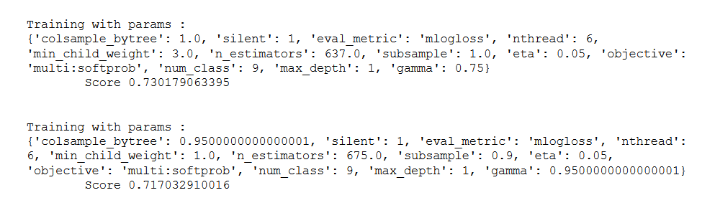
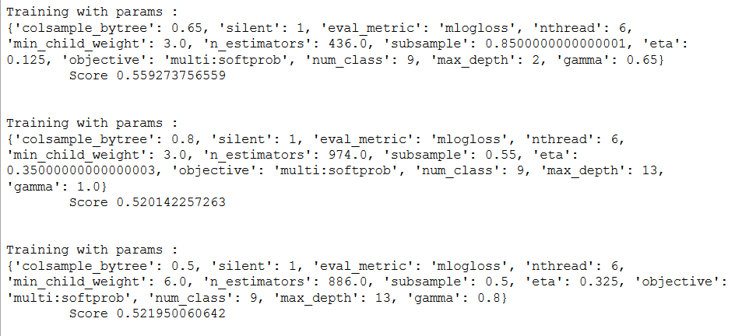

Slide 8
Conclusion

